Slide 1
scRGOT Coder Upgrade: Spatial Transcriptomics
Corinne Strawser, PhD
Bioinformatics Scientist
Dr. Elaine Mardis & Dr. Katie Miller Labs
Institute for Genomic Medicine

Slide 2
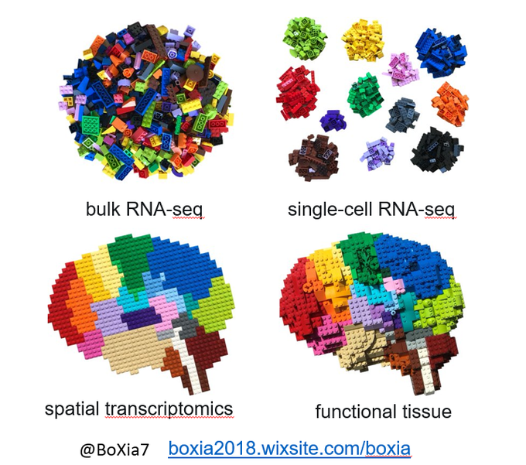
Why spatial?
Complex Tissue
Bulk RNA-seq
Single-cell RNA-seq
Spatial Transcriptomics
Networks of many cells each with individual gene expression patterns that regulate interactions and ultimately tissue function
tissue-average
gene expression
Cell-specific
gene expression
region-, cell-, or
subcellular-specific
gene expression with
spatial context
https://boxia2018.wixsite.com/boxia (@BoXia7)
Notes:
Functional tissue = networks of interacting cells.
Advances in sequencing technologies have revealed specificity in transcription.
bulk tissue = cell average level
scRNA-seq = limited ability to achieve adequate representation of all cell types and transcripts in a tissue and lack spatial context
Spatial transcriptomics = Eliminate need to liberate viable and rare cells from a tissue

Slide 3
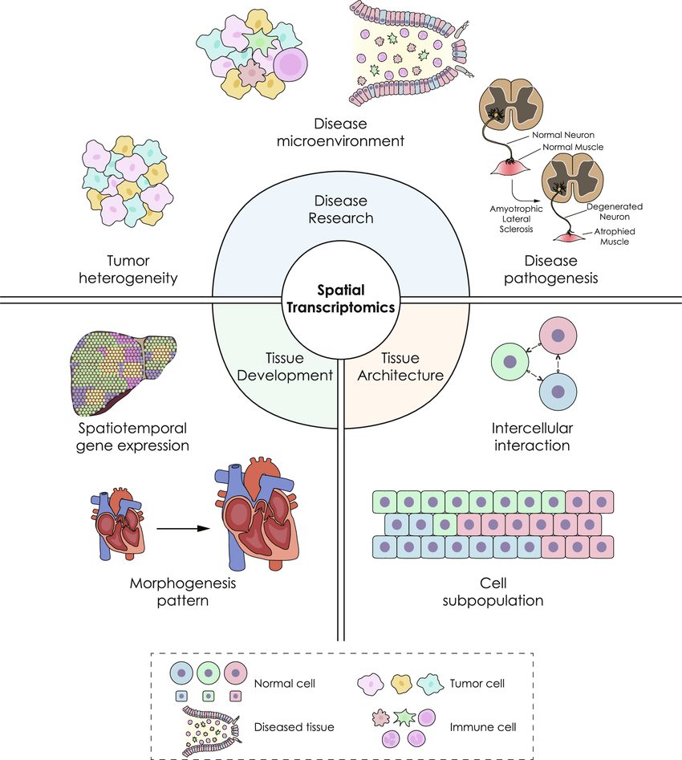
Spatial transcriptomics has broad applications
Du, Jun & Yang et al. (2023). Advances in spatial transcriptomics and related data analysis strategies. Journal of Translational Medicine. https://doi.org/10.1186/s12967-023-04150-2.
Notes:
Spatial transcriptomics has broad applications from
tissue development where we might be interested in the spatial and temporal nature of gene expression during stages of growth
tissue architecture where we might be interested in how certain cell subpopulations interact
disease development and progression where we might be interested in which cells are in close contact in the microenvironment

Slide 4
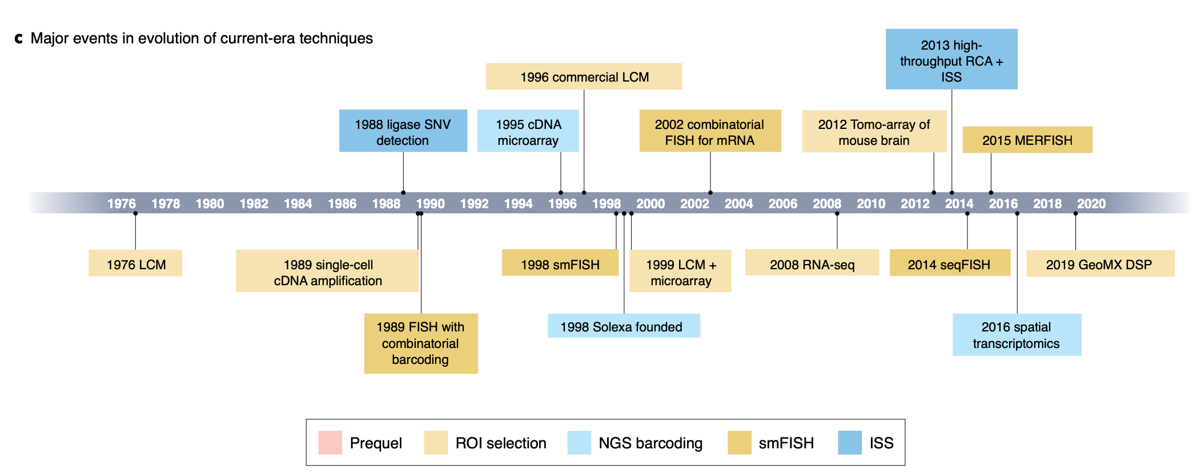
Spatial transcriptomics is not “new”…
Moses, L., & Pachter, L. (2022). Museum of spatial transcriptomics. Nature methods. https://doi.org/10.1038/s41592-022-01409-2
Notes:
Basic foundation for many of today’s current technologies was built between the late 1970’s and early 2000’s including:
the first laser capture microscopy publication in 1976
the first cDNA microarray in 1995
the first single molecular FISH publication in 1998

Slide 5
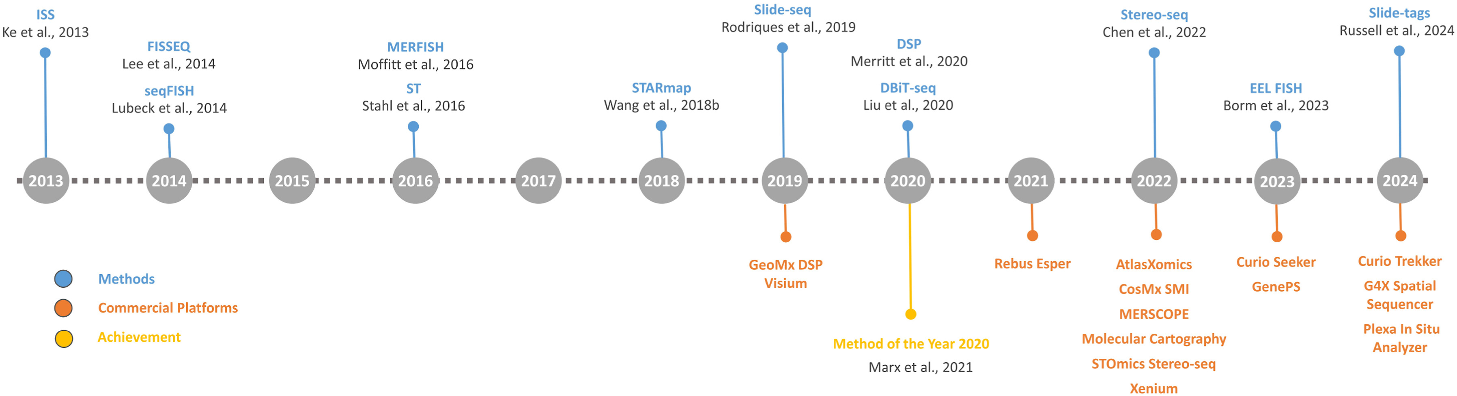
…but it’s expanding!
Valihrach, L., et al (2024). A practical guide to spatial transcriptomics.
Molecular aspects of medicine. https://doi.org/10.1016/j.mam.2024.101276

Slide 6
Microfluidics
in situ sequencing
(ISS)
Dissection
Arrays
in situ hybridization
(ISH)
Sequencing-based
Imaging-based
Nanoballs
Beads
Spatial
Transcriptomics
extract mRNA expression +
preserve spatial information
imaging RNAs in place

Slide 7
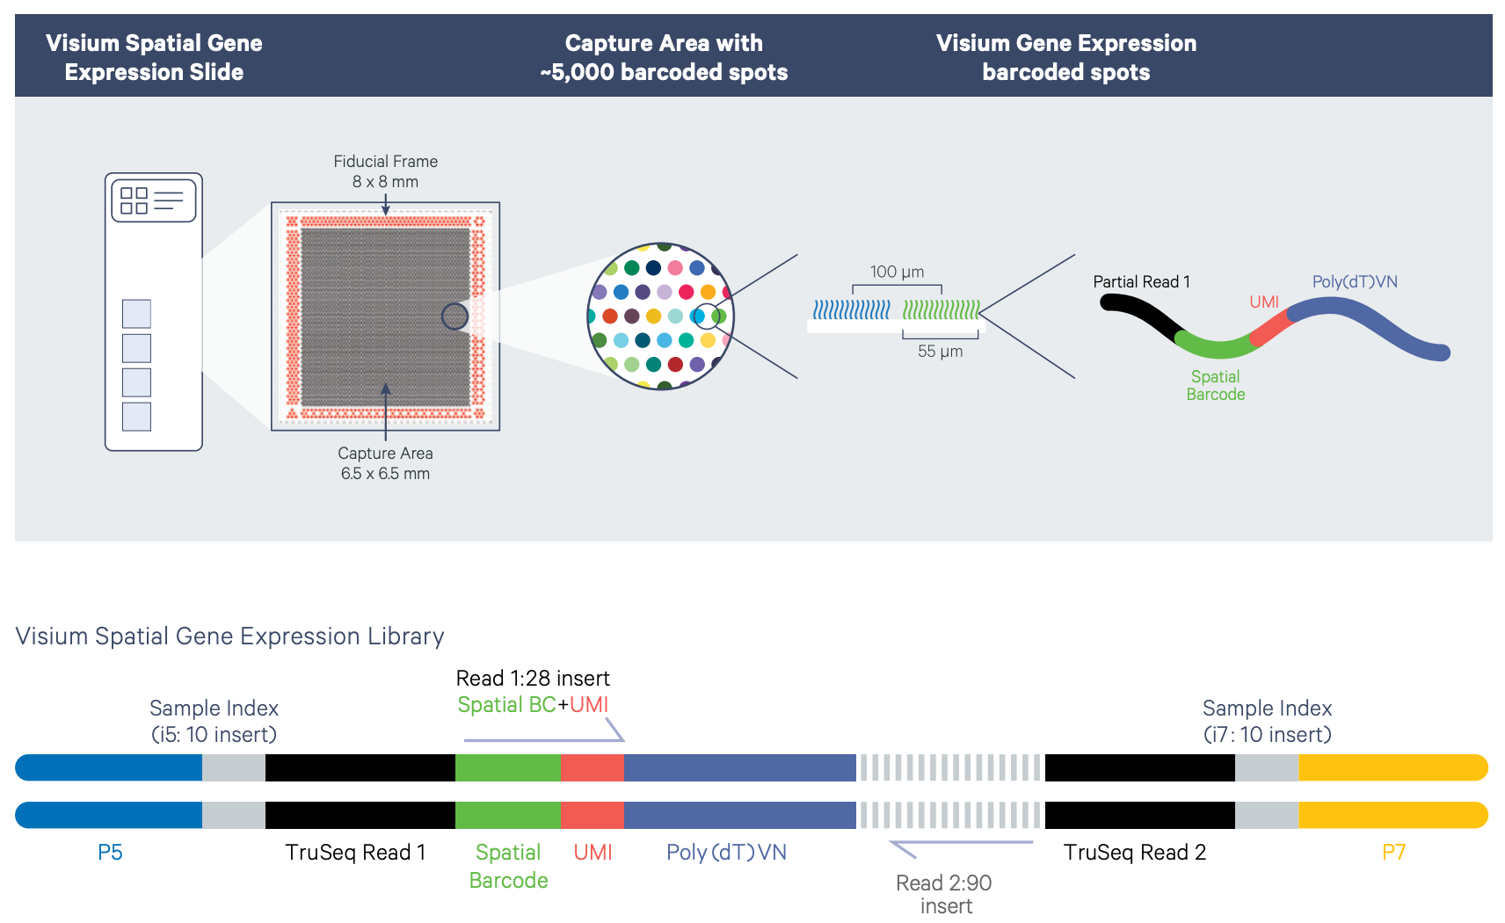

10X Genomics Visium
Visium slides has two or four capture areas of either 6.5 x 6.5 mm or 11 x 11 mm.
~5,000 capture spots (6.5 x 6.5 mm capture area)
~14,000 barcoded spots (11 x 11 mm capture area)
Each spot has millions of oligonucleotides with:
poly(dT) sequence for the capture of polyadenylated molecules
UMI used for the identification of duplicate molecules that arise during the library preparation and sequencing process
Spatial Barcode, which is shared by all oligonucleotides within each individual gene expression capture spot

Slide 8
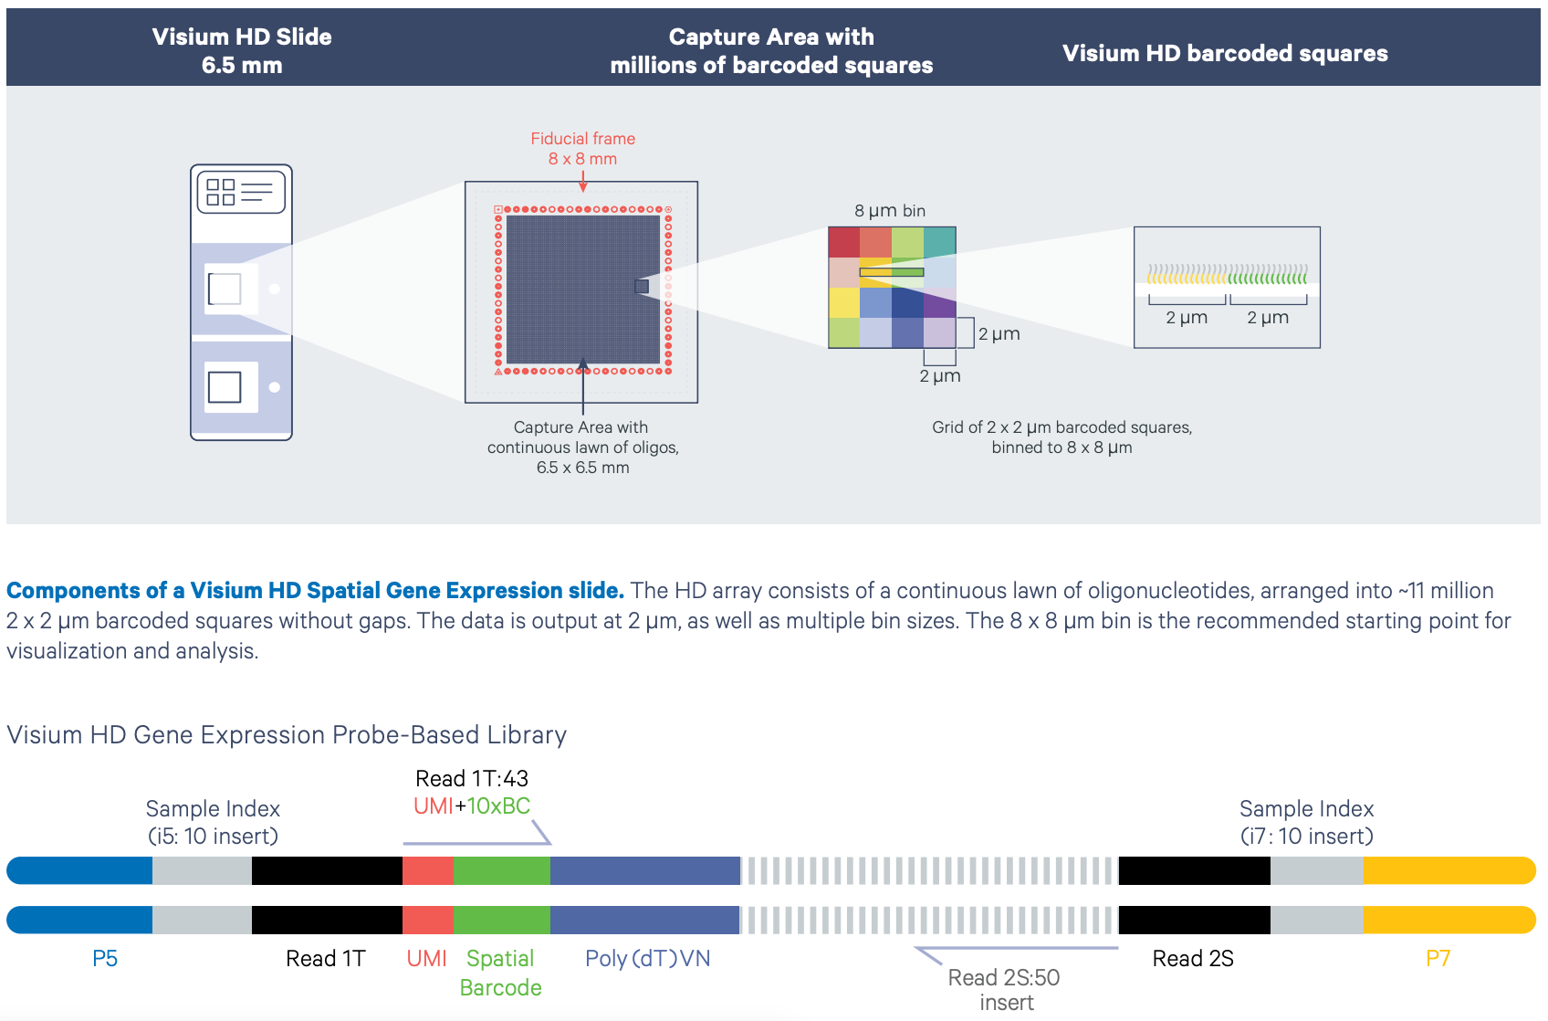
10X Genomics Visium HD
The HD slide has two capture areas, each 6.5 x 6.5 mm
~ 11 million 2 x 2 µm barcoded squares without gaps
Oligonucleotides each have
poly(dT) sequence for capture of the ligation product
UMI for the identification of duplicate molecules that arise during the library preparation and sequencing process
Spatial Barcode

Slide 9
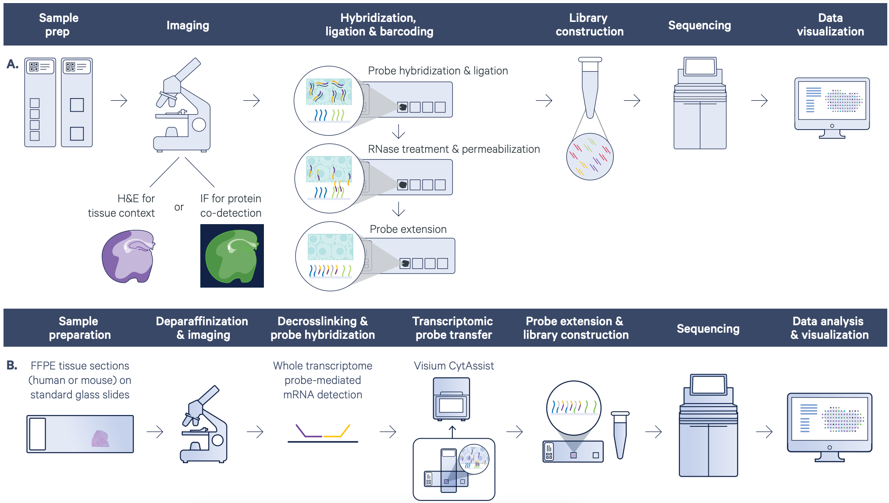
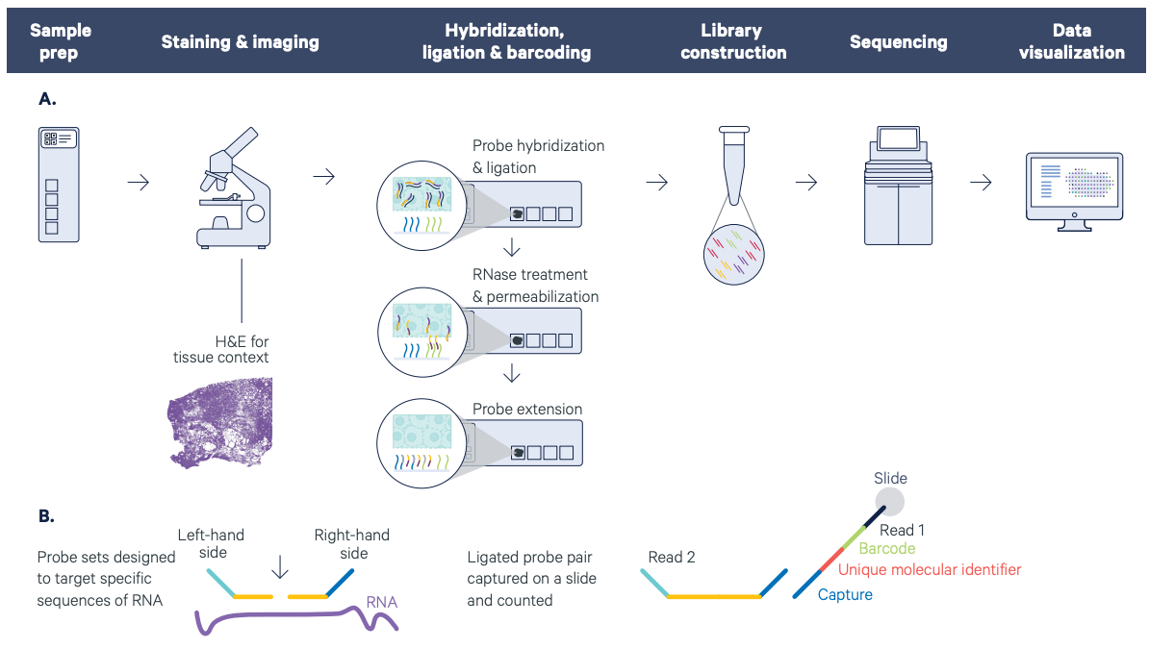
10X Genomics Visium Workflows
poly-A
Visium
Workflow
SEQUENCING REQUIREMENTS
Probe-based
Visium &
Visium HD
workflow

Slide 10
10X Genomics Visium and Visium HD
PRO
CON
Very well documented
Microscopy image
FFPE, fresh frozen, and fixed frozen (HD and LD v2) or fresh frozen (LD v1)
Protein co-detection
Customizable
Any species (LD v1)
U-Pick: subcellular (HD) or multi-cellular (LD)
Probe-based (HD & LD v2) – Visium HD 3’ coming soon
CytAssist required (HD & LD v2)
Mouse or human (HD & LD v2)

Slide 11
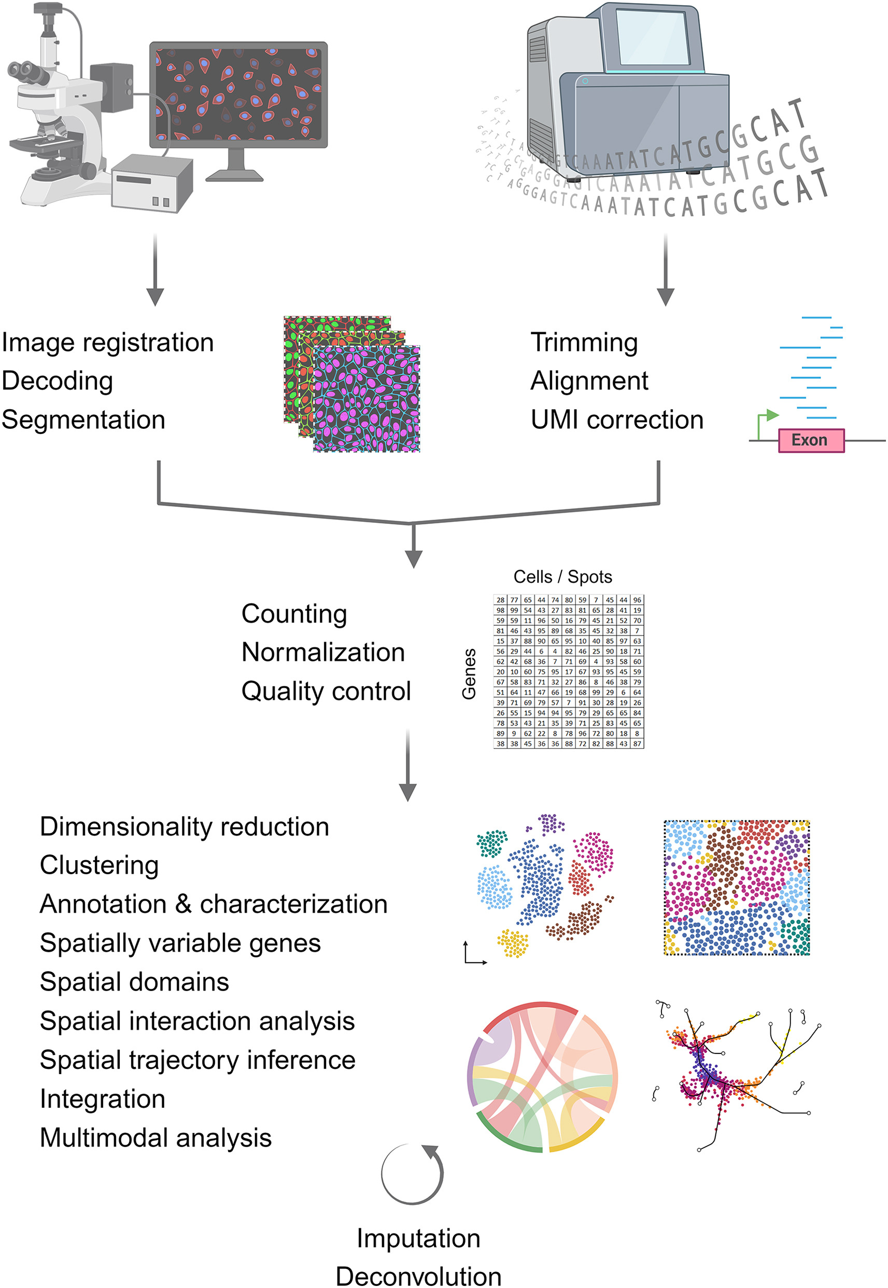
Spatial Transcriptomics Analysis
Raw-data processing
Pre- processing
Downstream analysis
Imaging-based
Image registration
Decoding
Segmentation
Sequencing-based
Normalization
Integration
Imputation
Dimensionality reduction
Clustering
Deconvolution
Multimodal analysis
Annotation & characterization
Spatially variable genes
Spatial domains
Spatial interaction analysis
Spatial trajectory inference
Counting
Quality control
Trimming
Alignment
UMI correction
Valihrach, L., Zucha, D., Abaffy, P., & Kubista, M. (2024). A practical guide to spatial transcriptomics. Molecular aspects of medicine, 97, 101276. https://doi.org/10.1016/j.mam.2024.101276

Slide 12
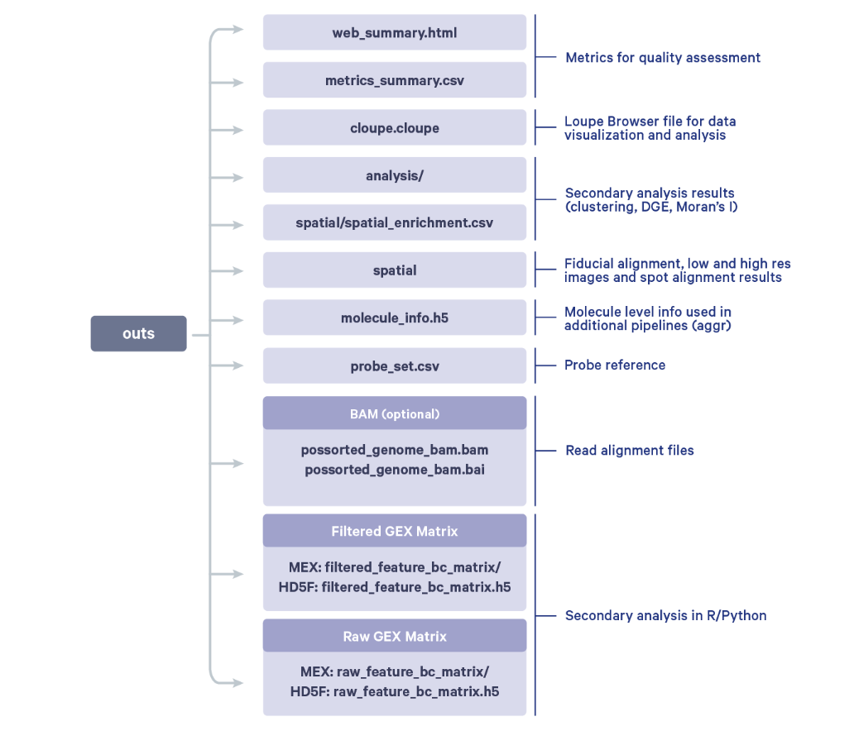
Raw data processing:
Space ranger example script

Slide 13

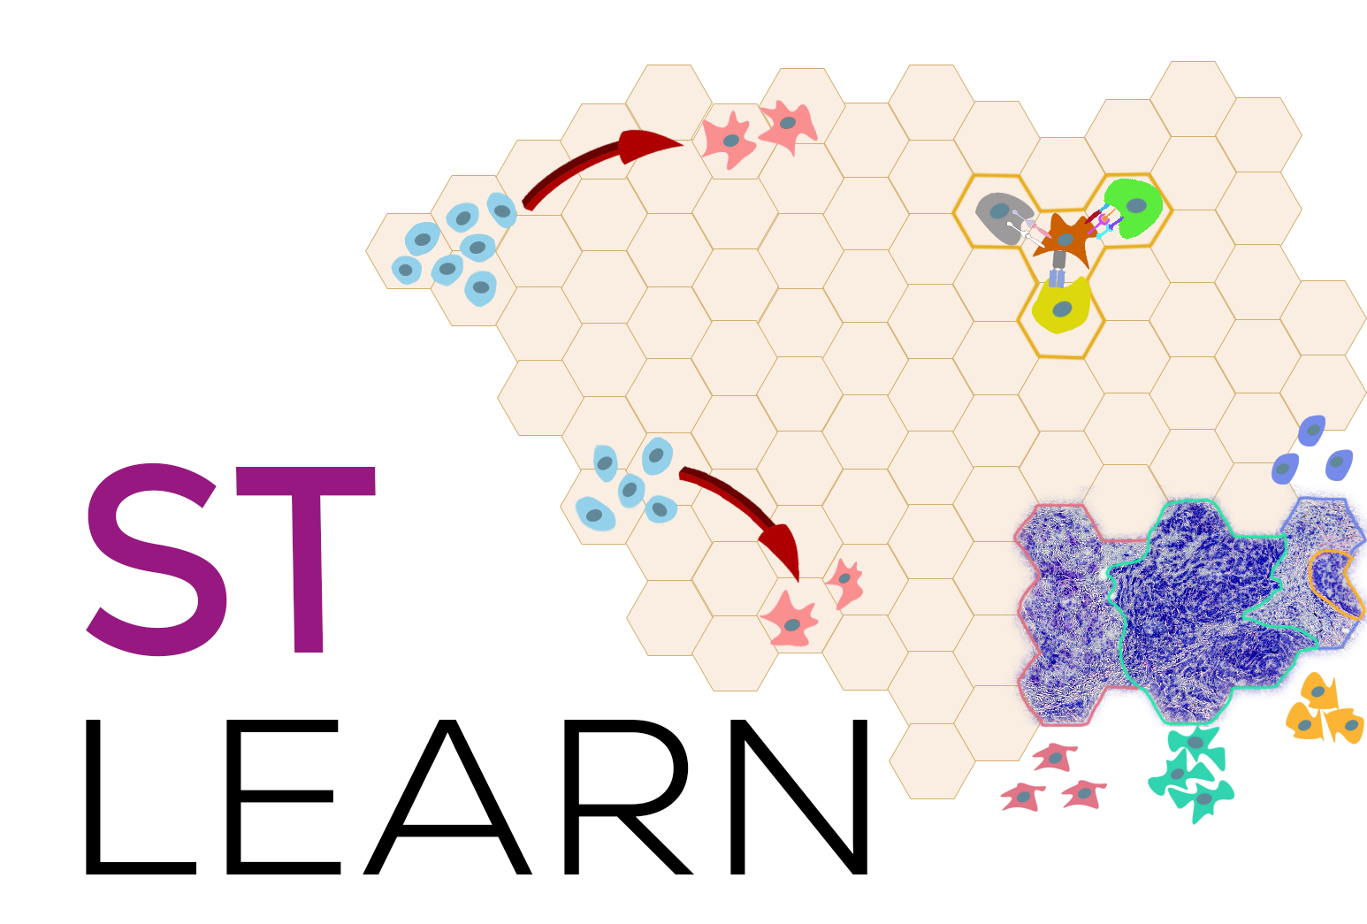






Downstream analysis: choose your own adventure!
:
Giotto
:
Giotto
(formerly STUtility)

Slide 14
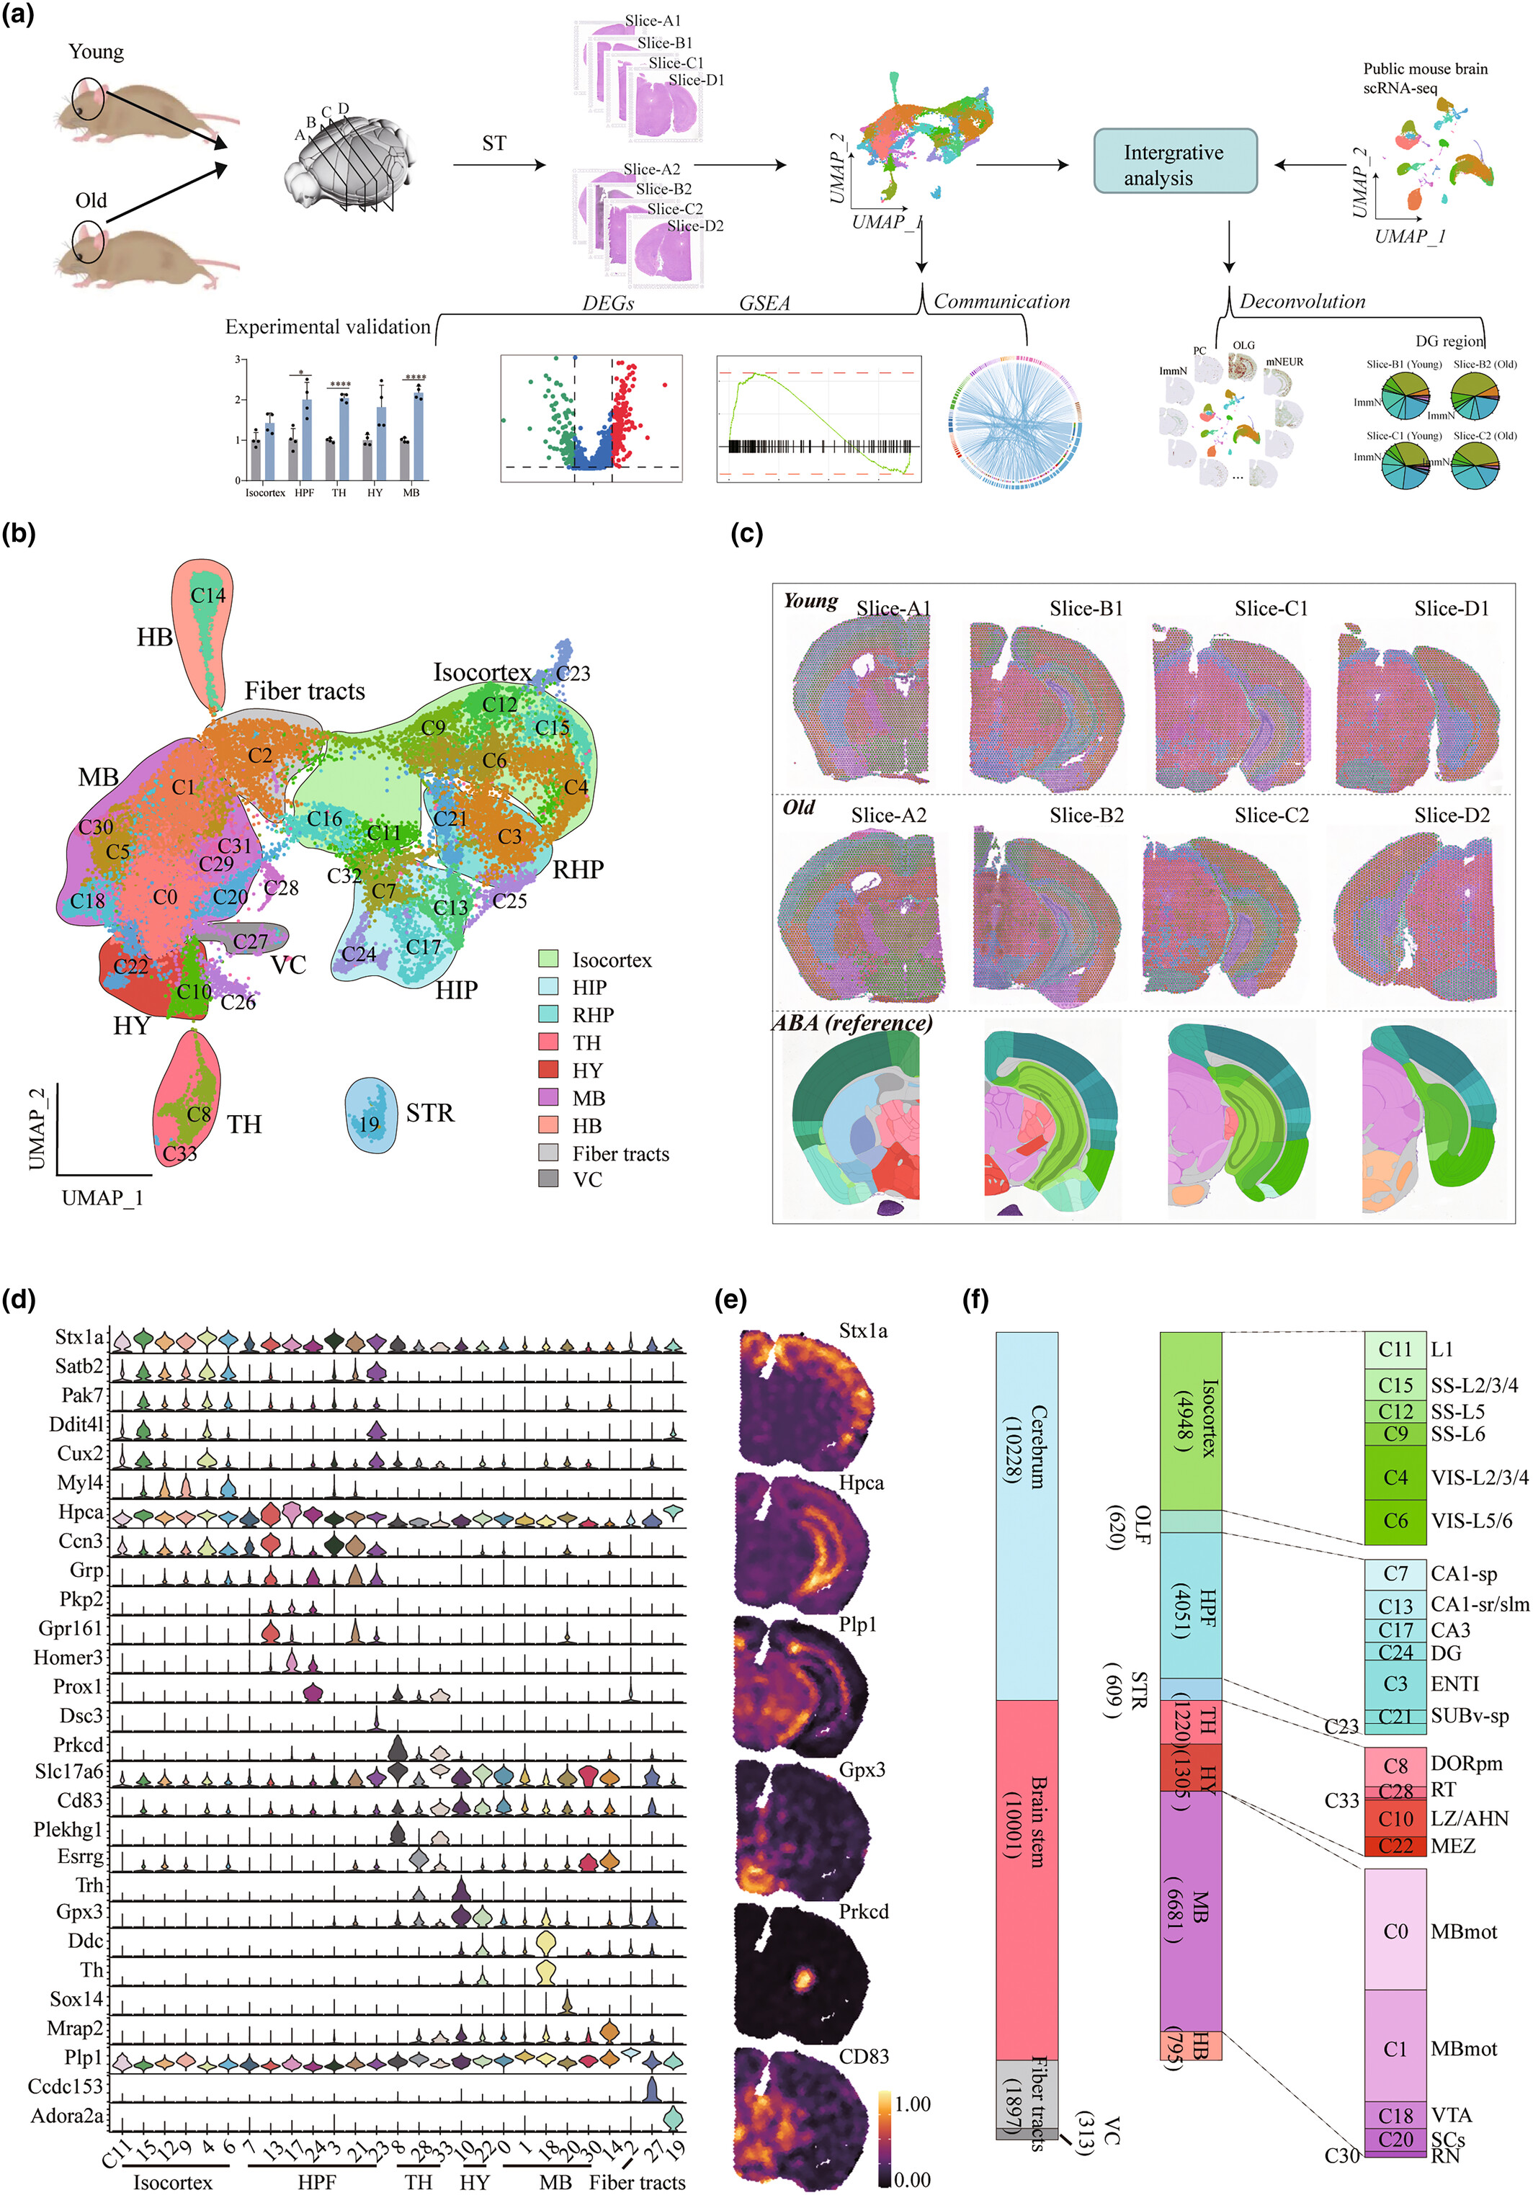
Today’s data:Spatial transcriptomic map of aging mouse brain
Wu and Tu et al. 2024. Spatially resolved transcriptome of the aging mouse brain. Aging Cell.
https://doi.org/10.1111/acel.14109

Slide 15
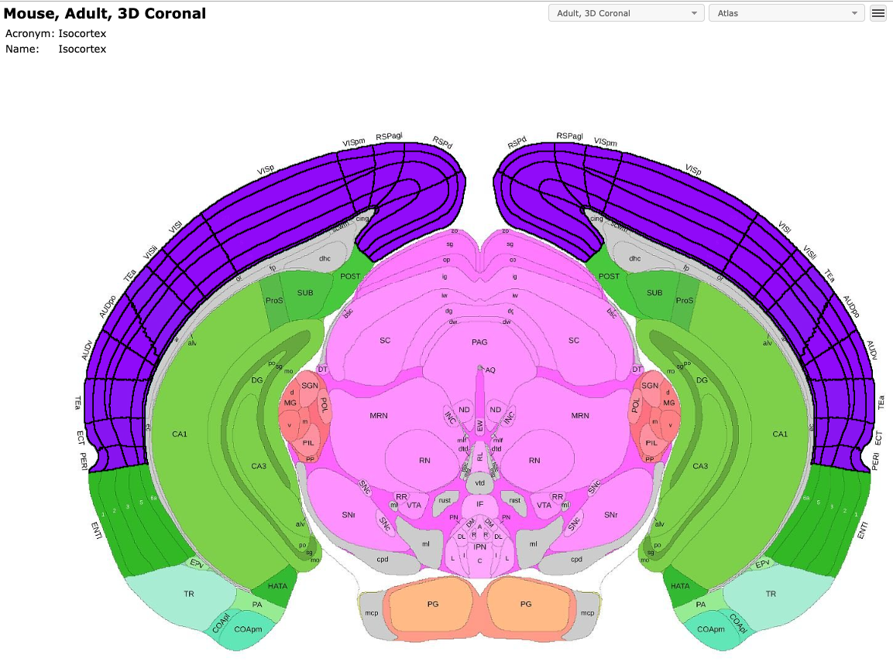
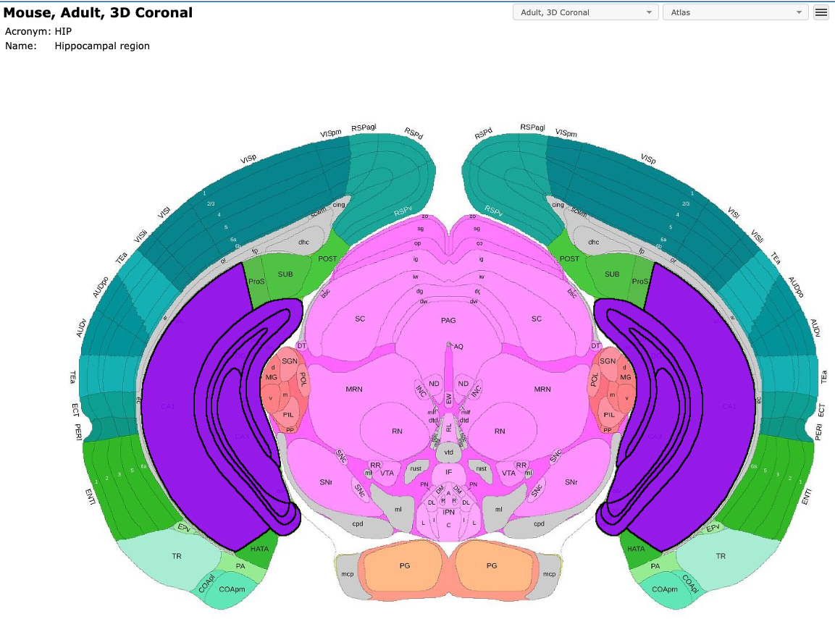
Regions of Interest (ROI)

Slide 16
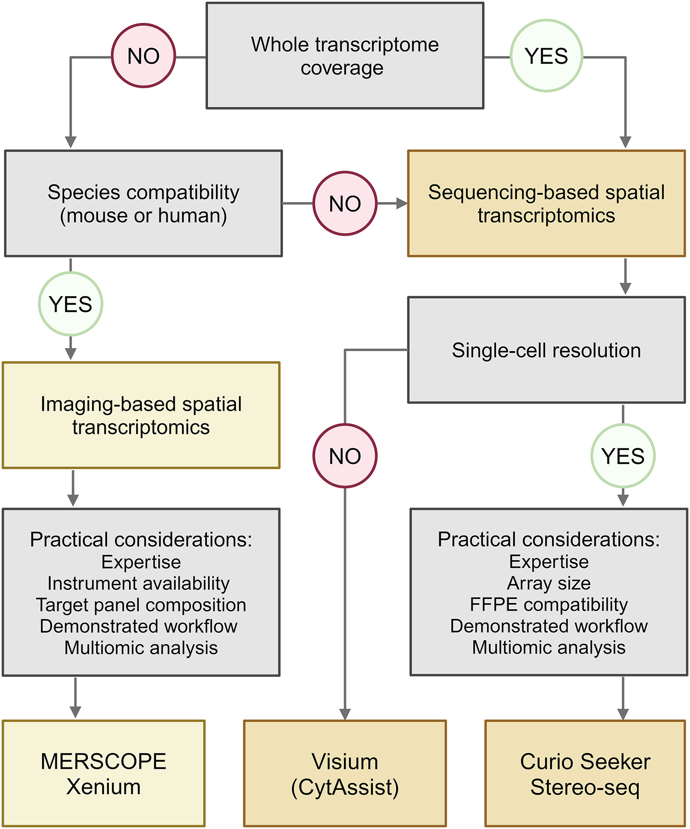
Experimental Considerations
Experimental design
Hypothesis generation or testing?
Target (gene or cell) detectability
Rare cells will be hard to identify with a low-res technology
Transcripts with low expression may be difficult to profile with a technology that has low capture efficiency
Tissue type and species
Availability of reference data for cell deconvolution
Availability of cell segmentation software
Tissue section type and quality
+ FlowGel
Valihrach, L., Zucha, D., Abaffy, P., & Kubista, M. (2024). A practical guide to spatial transcriptomics. Molecular aspects of medicine, 97, 101276. https://doi.org/10.1016/j.mam.2024.101276

Slide 17
Other spatial -omics
DNA sequencing: slide-DNA-seq (Zhao et al., 2022)
Epigenomics: ATAC-seq (Deng et al., 2022) and CUT&TAG (Deng et al., 2022) both available with FlowGel assay by AtlasXomics
Proteomics: CODEX (Goltsev et al., 2018), Immuno-SABER (Saka et al., 2019), scDVP (Rosenberger et al., 2023), RIBOmap (Zeng et al., 2023), CITE-seq (Liu et al., 2023), Stereo-CITE-seq (Liao et al., 2023)
Metabolomics: MSI (Unsihuay et al., 2021) and scSpaMet (Hu et al., 2023)
Temporally-resolved: intMEMOIR (Chow et al., 2021), Spatial iTracer (He et al., 2022), Space-TREX (Ratz et al., 2022)
Enable lineage tracing using CRISPR-Cas9 scarring or lentiviral barcoding!
Notes:
temporally-resolved techniques enable lineage tracing using Crispr-cas9 scarring or lentiviral barcoding, although challenges related to sensitivity and resolution remain

Slide 18
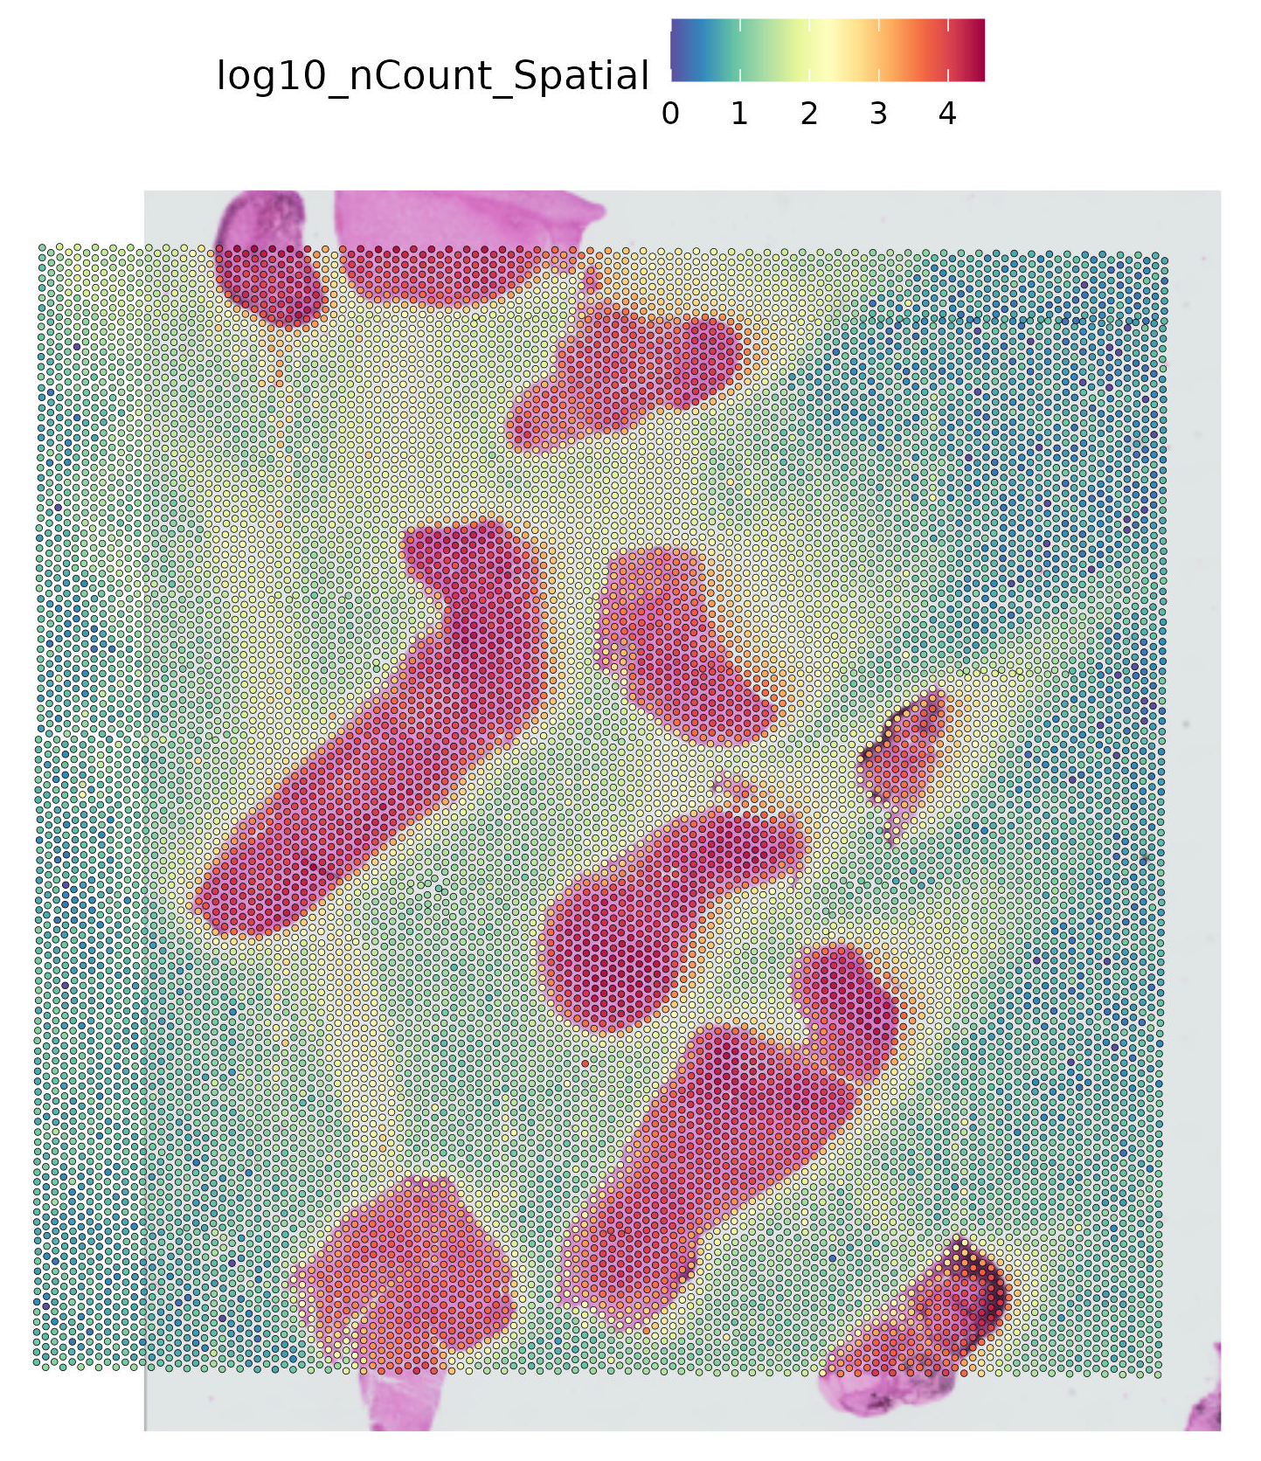
What challenges remain?
Compatibility with wider range of tissues
Optimize data storage and processing speed
Optimize spatial resolution and capture efficiency
Reduce signal diffusion
ST-specific normalization and batch correction
Registration across slices
Integration with multi-omics
Increased throughput, reduced cost, greater accessibility

